Slide 1
Level 3 Reform – update - The current stage of the reforms – qualification funding removal in 2024/25 - Pearson qualifications we are appealing - The current stage in context of the broader reforms
Sian Owen sian.owen1@pearson.com
June 2022

Slide 2
The current stage of the reforms – qualification funding removal in 2024/25

Slide 3
What is happening?
Technical qualifications that overlap with T levels in Waves 1 and 2 are due to be defunded in 2024 / 2025.
On 11 May 2022, the DfE published the provisional list of qualifications that will no longer be funded from academic year 2024 / 2025 for 16-19 learners in England due to overlap.
Awarding bodies can appeal qualifications they think should not be on the list – with evidence.
Of the 160 qualifications identified, 41 are Pearson qualifications.

Slide 4
Why are qualifications on the list?
Qualifications had to meet three overlap tests AND not be an exception
Overlap tests – if Y to all, in scope
Test 1: Is the qualification technical - primary purpose aims to support entry to employment in a specific occupational area(s)?
Test 2: Are the outcomes of the qualification similar to those set out in an occupational standard covered by a T Level in Waves 1 and 2?
Test 3: Does the qualification aim to support entry to the same occupations as a T Level in Waves 1 and 2?
Exceptions – not in scope
Exception A: The qualification is primarily designed to support those already in a job role, as our criteria for withdrawing funding is aimed at qualifications that overlap with the content and purpose of T Levels, including supporting entry into the same occupation as a T Level.
Exception B: The qualification is aligned with an occupational route within Waves 3 and 4 T Levels, to ensure that we do not remove overlapping provision before Waves 3 and 4 T levels are widely available.

Slide 5
How can awarding organisations appeal?
We can appeal the DfE decision to put qualifications on the list if we believe they do not meet all three tests above, or, they should have been considered an exception. I.e. the qualification:
Is academic and not technical.
Does not partially overlap with the outcomes of a T Level in that the content, learning, and assessment outcomes needed to attain the qualification are not set out in an occupational standard covered by a T Level.
Does not aim to support entry to the same occupation(s) as a T Level but aims to support entry into a different specific occupation.
Meets the 3 overlap tests but is aimed at those already in work.
Meets the 3 overlap tests but is also aligned with an occupational route within wave 3 and 4 T Levels.

Slide 6
Timelines
11 May 2022: DfE publish the list
8 July: AOs submit evidence
September 2022: DfE publish final list
The qualifications on the final list will be defunded in 2024/25. Learners will be funded until completion for any courses they start.
The process does not affect qualification funding in 2022/23 and 2023/24.
All other BTEC Nationals in Applied Science, Health and Social Care, Construction, Engineering, CPLD (360 GLH)​, Applied Psychology, Applied Biology ​are not affected. The process does not affect qualification funding in 2022/23, 2023/24, and 2024/25. These qualifications will all be subject to reform and reapproval in 2025/26.

Slide 7
Pearson qualifications we are appealing

Slide 8
Which qualifications are impacted?
Of the 41 Pearson qualifications on the provisional list for defunding for 16-19 study programmes in 2024/25:
We are not appealing 27 qualifications.
We are appealing 14 qualifications:
12 Engineering qualifications
(and one Construction qualification and one Health and Social Care qualification).

Slide 9
What are Pearson appealing and what evidence is needed?
12 Engineering qualifications:
QAN | Title | Evidence we need your help with
601/7582/5 | Pearson BTEC Level 3 National Diploma in Manufacturing Engineering | Minimum of 5 supporting letters from current employers that the qualification has been used regularly in the last 3 years to support entry to occupations supported by Waves 3 and 4 T Levels. Professional bodies can also provide support.
601/7589/8 | Pearson BTEC Level 3 National Extended Diploma in Manufacturing Engineering
601/7583/7 | Pearson BTEC Level 3 National Diploma in Mechanical Engineering
603/5840/3 | Pearson BTEC Level 3 Foundation Award in Advanced Manufacturing Engineering (Development Technical Knowledge)
601/9053/X | Pearson BTEC Level 3 Award in Advanced Manufacturing Engineering (Development Technical Knowledge)
601/9049/8 | Pearson BTEC Level 3 Certificate in Advanced Manufacturing Engineering (Development Technical Knowledge)
601/9054/1 | Pearson BTEC Level 3 Diploma in Advanced Manufacturing Engineering (Development Technical Knowledge)
601/9060/7 | Pearson BTEC Level 3 Extended Diploma in Advanced Manufacturing Engineering (Development Technical Knowledge)
601/7591/6 | Pearson BTEC Level 3 National Foundation Diploma in Engineering | -
601/7580/1 | Pearson BTEC Level 3 National Diploma in Engineering | Min of 6 supporting letters from receiving HEIs / other receiving institutions
601/7588/6 | Pearson BTEC Level 3 National Extended Diploma in Engineering | Min of 6 supporting letters from receiving HEIs / other receiving institutions
601/7590/4 | Pearson BTEC Level 3 National Extended Diploma in Mechanical Engineering | Min of 6 supporting letters from receiving HEIs / other receiving institutions

Slide 10
How can I help with the appeals, or help Pearson develop the next generation of BTEC Nationals
Appeals: Please let us know about any evidence you can help us with by filling out your details here.
Next generation BTECs: As part of the Level 3 Vocational Qualification reforms we would like to invite you to help influence the next generation of BTEC Nationals. We want to ensure we capture the teacher and learner voice in our qualifications and support materials. Get involved by clicking here.

Slide 11
Where and when can I find more information?
Further information, and the link to the full list can be found on the Pearson website here: Educators | Your BTEC | Pearson UK.

Slide 12
The current stage in context of the broader reforms

Slide 13
How does this affect your curriculum planning?
2022/2023 and 2023/2024
No changes to vocational offer.
2024/2025
Subject to the outcomes of the appeals process, some qualifications which overlap with T Levels defunded in:
Digital,
Construction,
Education & Childcare,
Health & Science.
(I.e. Waves 1 & 2 T Level sectors.)
But no change to the majority of the vocational offer.
2025/2026
Some qualifications which overlap with T Levels defunded in:
Engineering & Manufacturing,
Legal, Finance & Accounting,
Business & Administration,
Agriculture, Environmental & Animal Care,
Catering & Hospitality,
Hair & Beauty,
Creative & Design.
Curriculum reform in:
Digital,
Construction,
Education & Childcare,
Health & Science,
Engineering & Manufacturing.
2026/2027
Curriculum reform in:
Legal, Finance & Accounting,
Business & Administration,
Agriculture, Environmental & Animal Care,
Catering & Hospitality,
Hair & Beauty,
Creative & Design.
And in all remaining sectors.

Slide 14
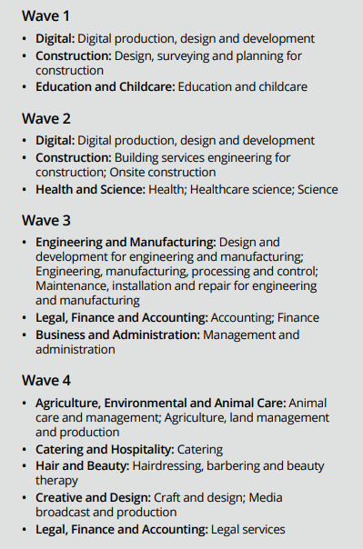
How does this fit with the wider reforms?
From 2024/25
Technical qualifications will no longer available where replaced by Wave 1 and 2 T Levels (for 16-19s only, funding may be retained for adults).
A draft list of qualifications which will no longer be available 2024/25 was published in May 2022, Awarding bodies can appeal the qualifications on the list. The final list will be confirmed by September 2022.
Any learners part way through a qualification will be able to complete their course.
From 2025/26
Technical qualifications will no longer be available where replaced by Wave 3 and 4 T Levels (for 16-19s only, funding may be retained for adults).
Reformed academic and technical qualifications which align to Wave 1 and 2 T Level routes, and Wave 3 Engineering and Manufacturing T Level routes will be introduced (16-19s and adults).
Reformed academic and technical qualifications which offer specialist and cross-cutting skills in the Digital route will be introduced (adults).
All remaining qualifications in the Wave 1 and 2 T Level routes, and Wave 3 Engineering and Manufacturing T Level routes that have not been reformed and re-approved for funding will no longer be available.
From 2026/27
Reformed academic and technical qualifications which align to remaining Wave 3 and 4 T Level routes will be introduced (16-19s and adults).
All remaining qualifications in the Wave 3 and 4 T Level routes that have not been reformed and re-approved for funding will no longer be available.
Reformed academic and technical qualifications in routes not covered by T Levels will be introduced (16-19s and adults). For example, Care Services; Protective Services; Sales, Marketing and Procurement; and Transport and Logistics.
All remaining qualifications in the routes not covered by T levels that have not been reformed and reapproved for funding will no longer be available.
Reformed academic qualifications in subjects not linked to occupational routes will be introduced (16-19s and adults).
All remaining qualifications that have not been reformed and re-approved for funding will no longer be available.

Slide 15
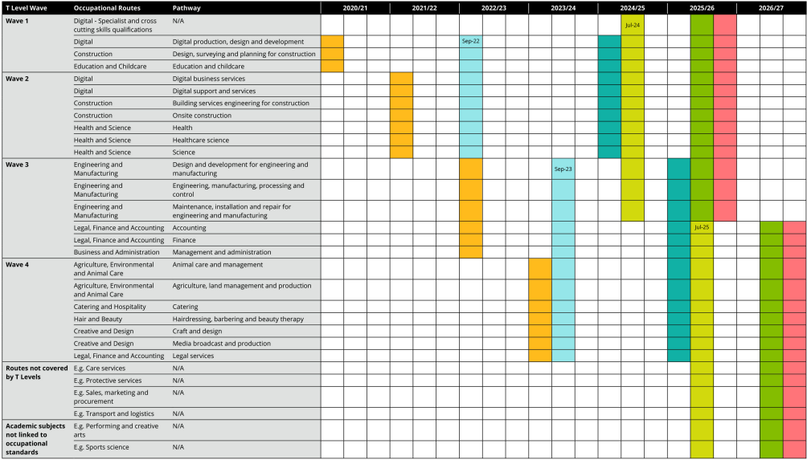

Slide 16
Q&A

